Slide 1
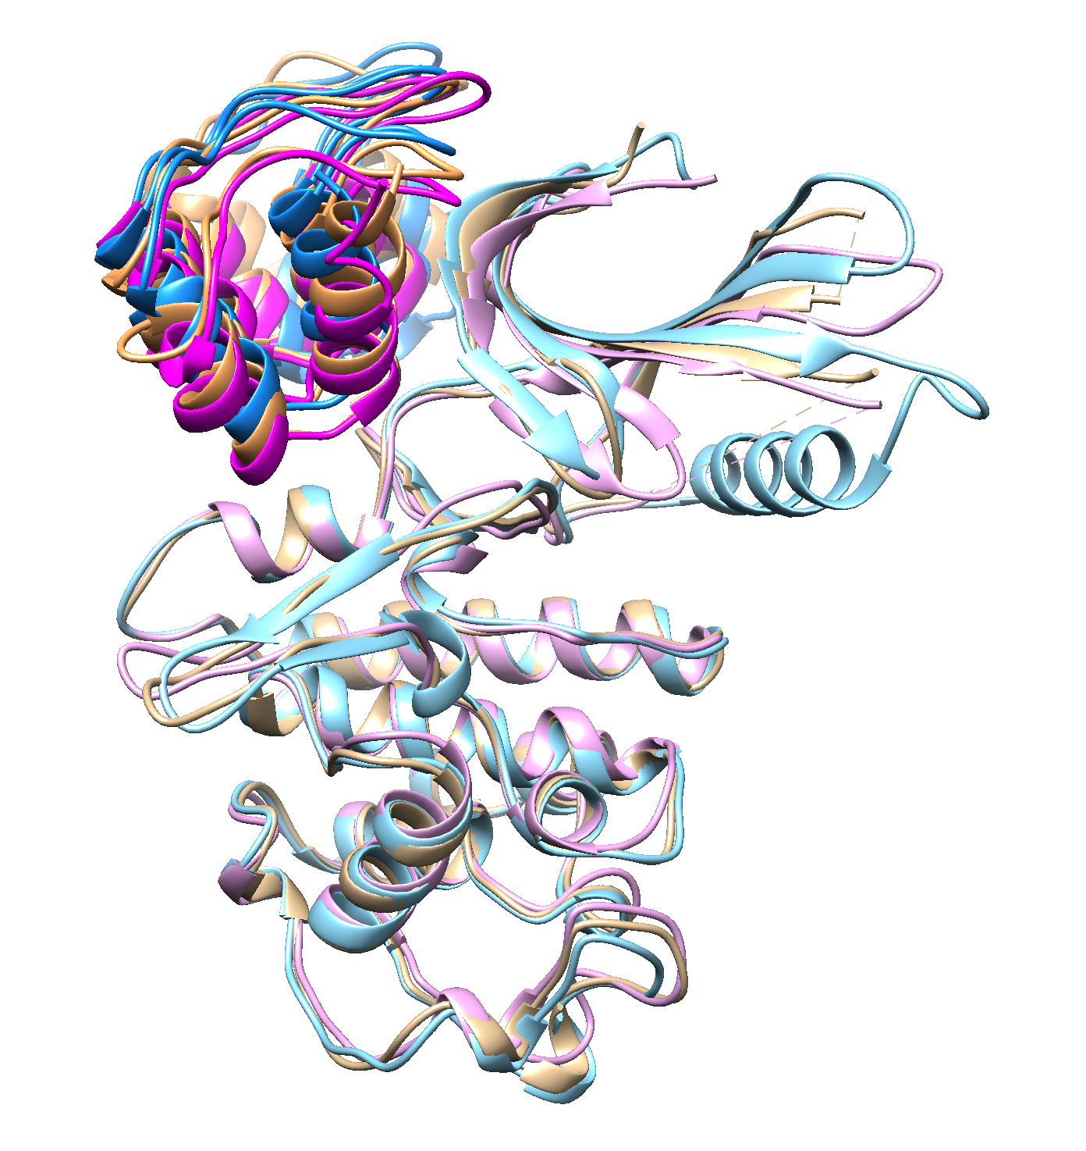
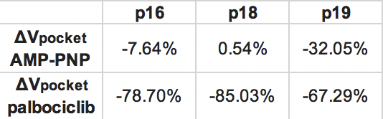
binding partner | PDB code | organism | mutation | CDK6 key residue (2.7 Å from INK4)
INK4A / p16 / CDKN2A | 1BI7 | human | none | E14, D102, D110
INK4B / p15 / CDKN2B | - | - | - | -
INK4C / p18 / CDKN2C | 1G3N | human | none | V16, E18, K29, R31, S155
INK4D / p19 / CDKN2D | 1BI8 | human | none | V16, K26, K29, R31
p16 : CDK6
p18 : CDK6
p19 : CDK6

Slide 2
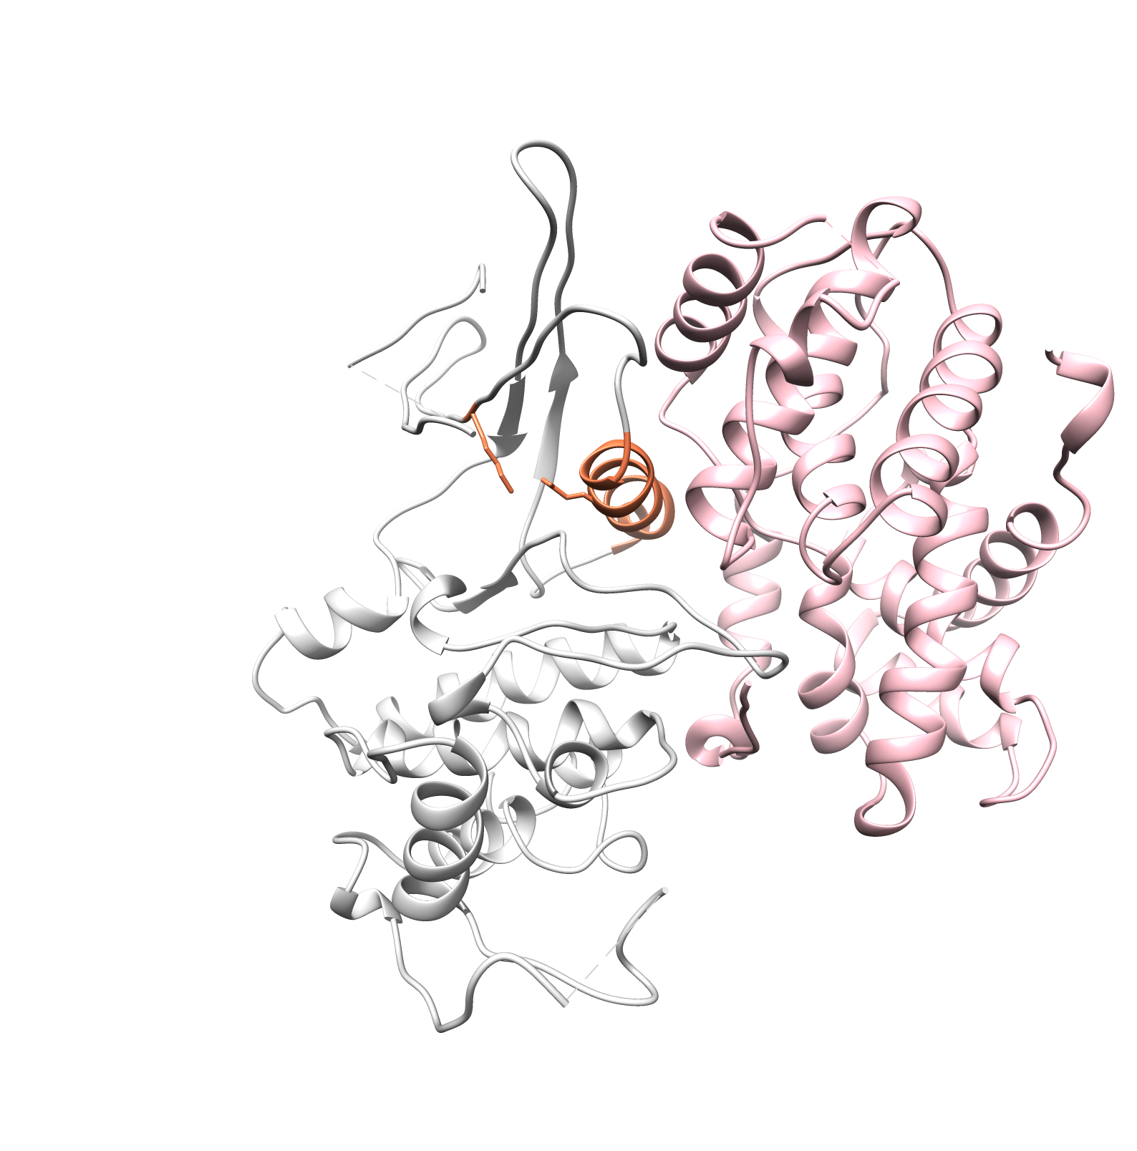
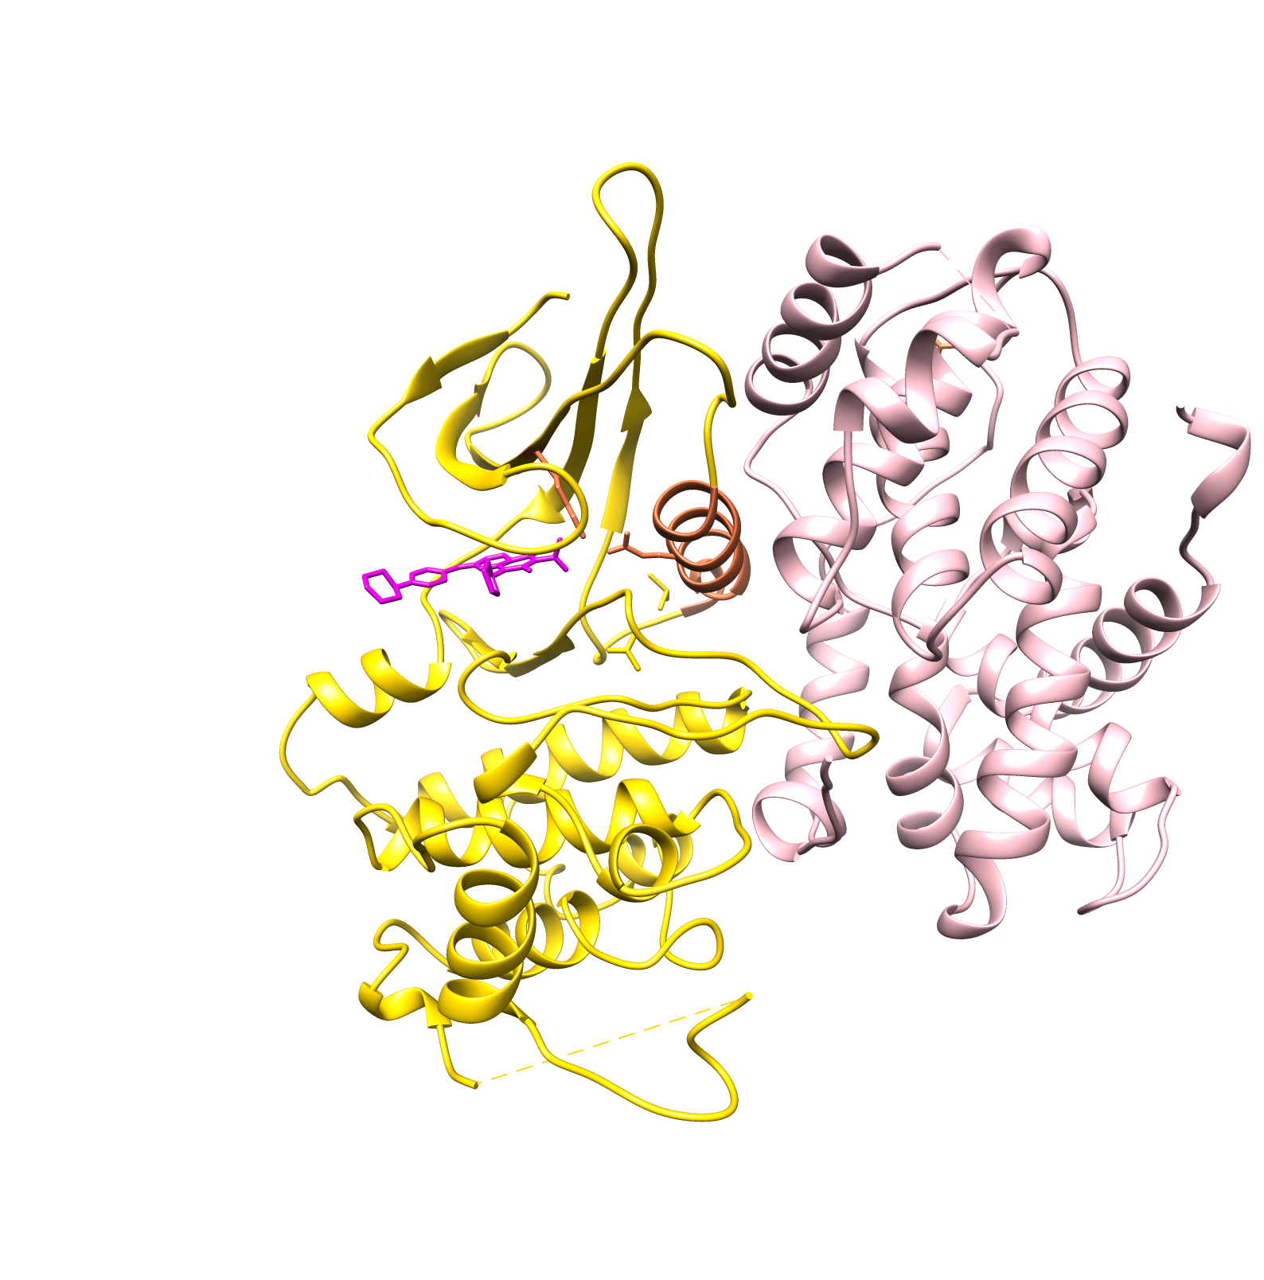
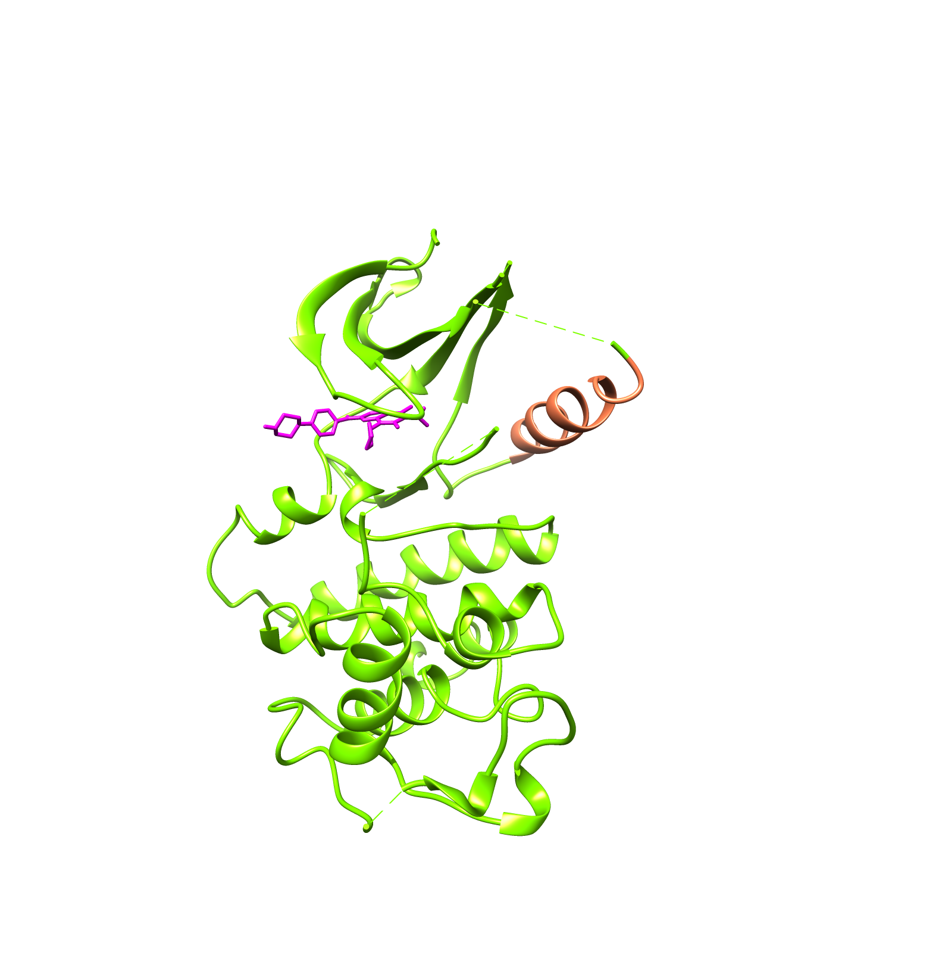
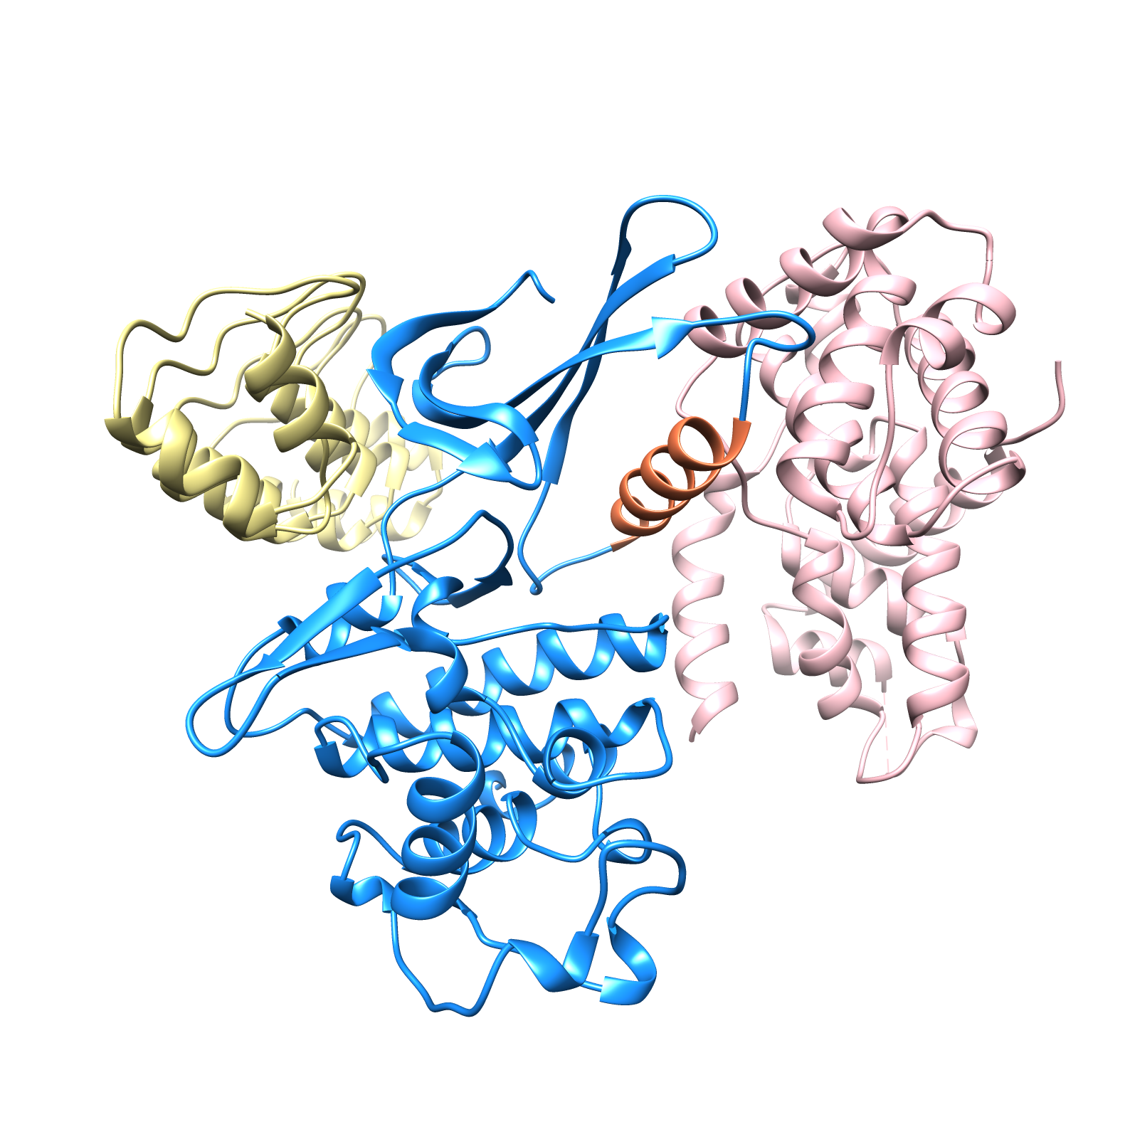
PDB | 2EUF | 5L2I | 1G3N
 | Palbociclib + Cdk6 + Vcyclin | Palbociclib + Cdk6 | INK4 + Cdk6 + Vcyclin
 | Helix-in | Helix-out | Helix-out
 | DFG-in | DFG-in | DFG-out
 | Active (K-E salt bridge on) | “Intermediate” | Inactive

Slide 3
 | CDK6 : p18 : cyclinD |  |  |  | CDK4 : p27 : cyclinD
Five-part model (in vivo) | BSJ-03-123 : CRBN |  | BSJ-05-017 : VHL |  | BSJ-03-123 : CRBN |  | BSJ-05-017 : VHL
 | 30 °C (303.15 K) | 127 °C (400.15 K) | 30 °C (303.15 K) | 127 °C (400.15 K) | 30 °C (303.15 K) | 127 °C (400.15 K) | 30 °C (303.15 K) | 127 °C (400.15 K)
 | CDK6 : cyclinD |  |  |  | CDK4 : cyclinD
Four-part model (in vitro) | BSJ-03-123 : CRBN |  | BSJ-05-017 : VHL |  | BSJ-03-123 : CRBN |  | BSJ-05-017 : VHL
 | 30 °C (303.15 K) | 127 °C (400.15 K) | 30 °C (303.15 K) | 127 °C (400.15 K) | 30 °C (303.15 K) | 127 °C (400.15 K) | 30 °C (303.15 K) | 127 °C (400.15 K)
 | * Experimental pH 7.5 was used to protonate the initial structure; ionic strength of 20mM MgCl2 was approximated; three independent runs (with different random seeds) were performed for each condition.

Slide 4
Full Models

Slide 5
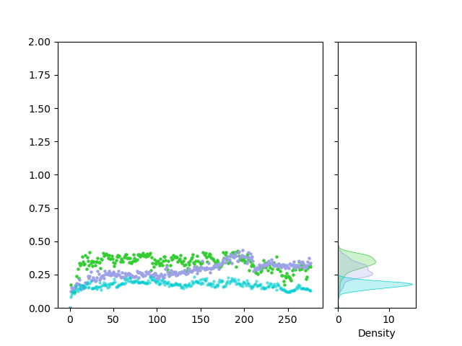
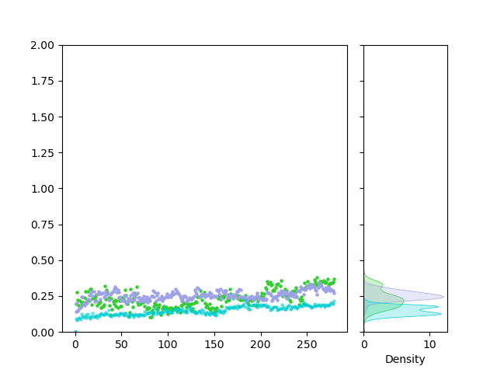
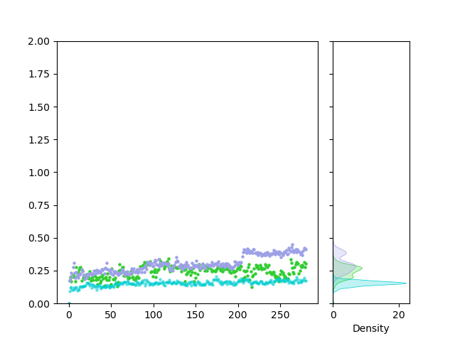
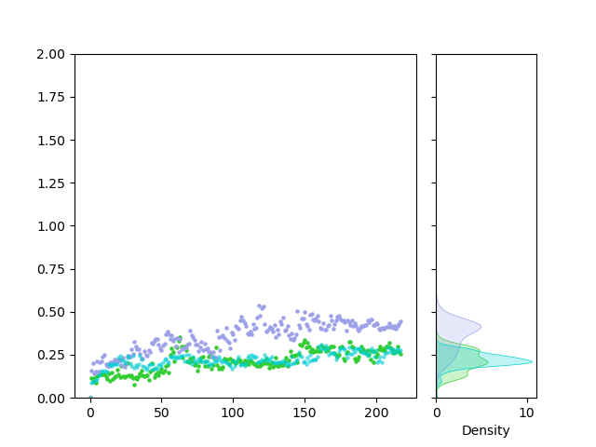
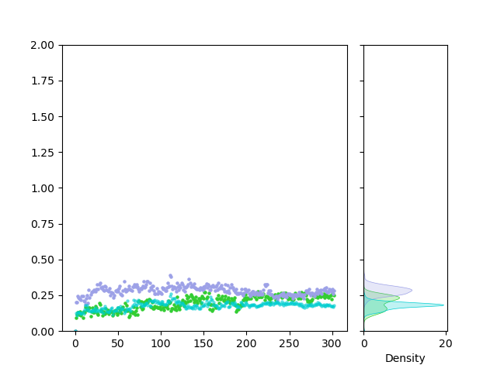
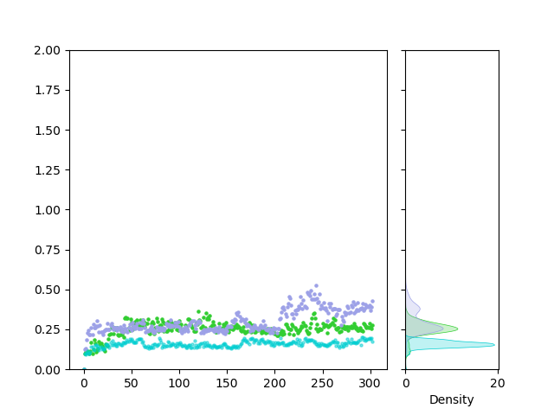
CRBN: BSJ-03-123 : CDK6/4 : p18/27 : cyclinD simulations (303.15 K)
CDK6_run 0
CDK6_run 1
CDK6_run 2
CRBN
BSJ-03-123
CDK6
Backbone RMSD (nm)
0 50 100 150 200 250
0 10
Density
0 100 200 300 400
0 10
Density
0 50 100 150 200 250
0 20
Density
CDK4_run 0
CDK4_run 1
CDK4_run 2
CRBN
BSJ-03-123
CDK4
Backbone RMSD (nm)
0 50 100 150 200
0 10
Density
0 50 100 150 200 250 300
0 20
Density
0 50 100 150 200 250 300
0 20
Density
simulation time (ns)
simulation time (ns)
simulation time (ns)

Slide 6
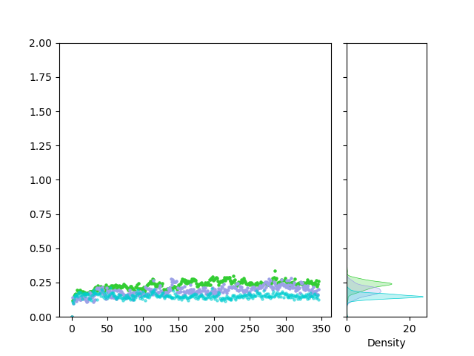
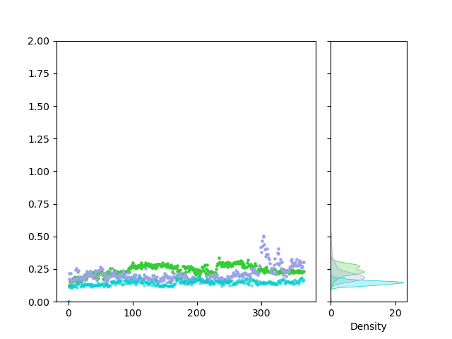
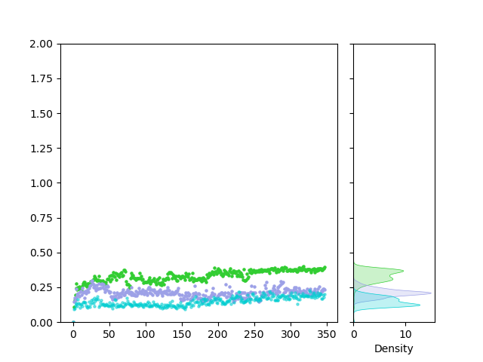
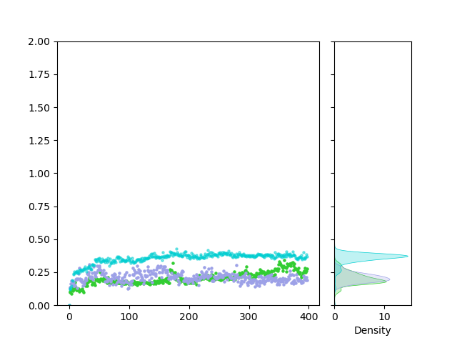
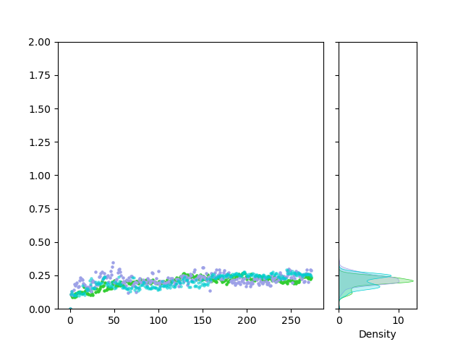
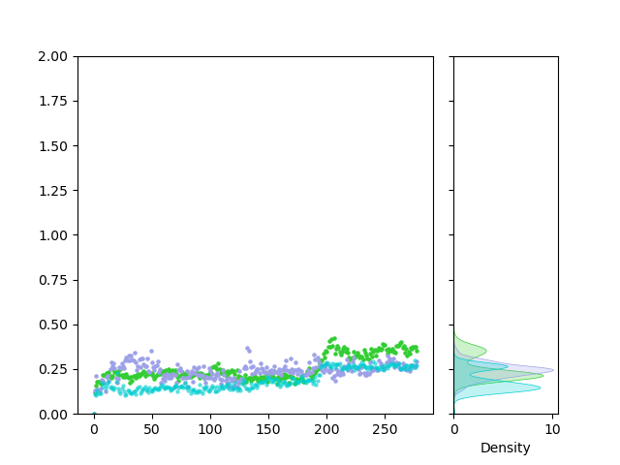
VHL: BSJ-05-017 : CDK6/4 : p18/27 : cyclinD simulations (303.15 K)
CDK6_run 0
CDK6_run 1
CDK6_run 2
VHL
BSJ-05-017
CDK6
Backbone RMSD (nm)
0 50 100 150 200 250 300 350
0 100 200 300
0 20
Density
0 50 100 150 200 250 300 350
0 20
Density
0 10
Density
0 10
Density
0 20
Density
CDK4_run 0
CDK4_run 1
CDK4_run 2
VHL
BSJ-05-017
CDK4
Backbone RMSD (nm)
0 100 200 300 400
0 10
Density
0 50 100 150 200 250
0 10
Density
0 50 100 150 200 250
0 10
Density
simulation time (ns)
simulation time (ns)
simulation time (ns)

Slide 7
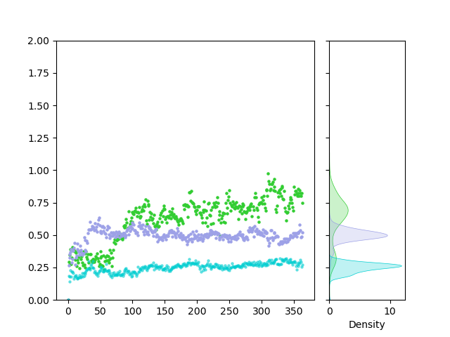
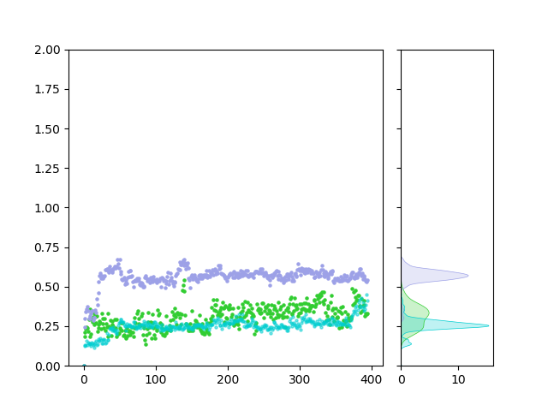
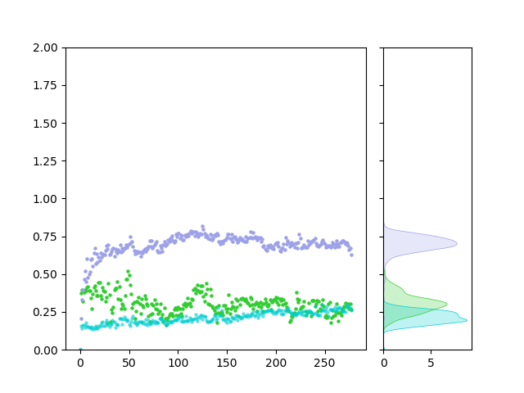

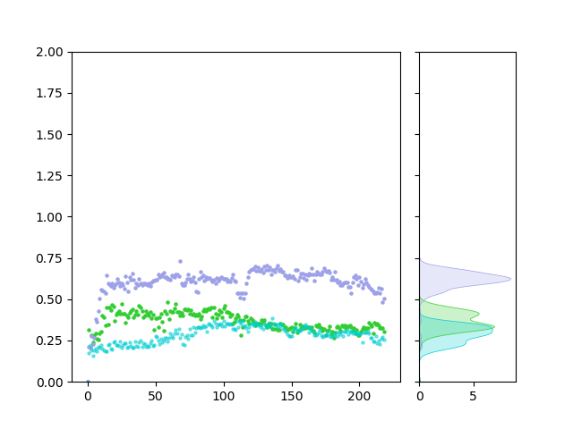
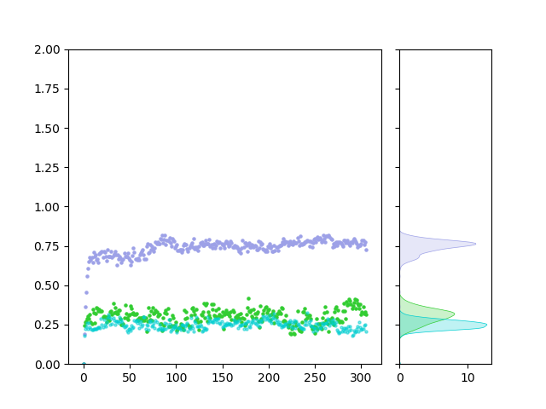
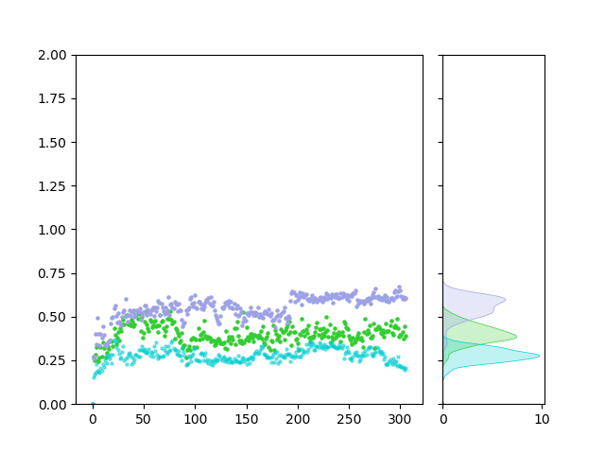
CRBN: BSJ-03-123 : CDK6/4 : p18/27 : cyclinD simulations (400.15 K)
CDK6_run 0
CDK6_run 1
CDK6_run 2
CRBN
BSJ-03-123
CDK6
Backbone RMSD (nm)
0 50 100 150 200 250 300 350
0 10
Density
0 100 200 300 400
0 10
Density
0 50 100 150 200 250
0 5
Density
CDK4_run 0
CDK4_run 1
CDK4_run 2
CRBN
BSJ-03-123
CDK4
Backbone RMSD (nm)
0 50 100 150 200
0 5
Density
0 50 100 150 200 250 300
0 10
Density
simulation time (ns)
simulation time (ns)
simulation time (ns)

Slide 8
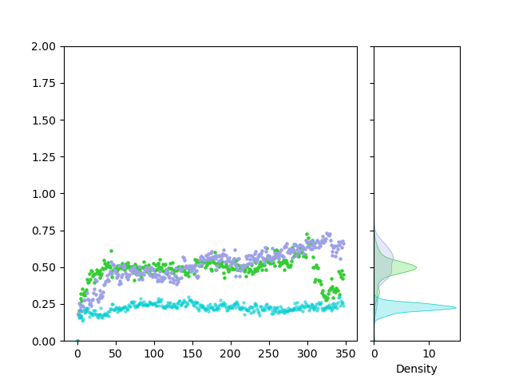
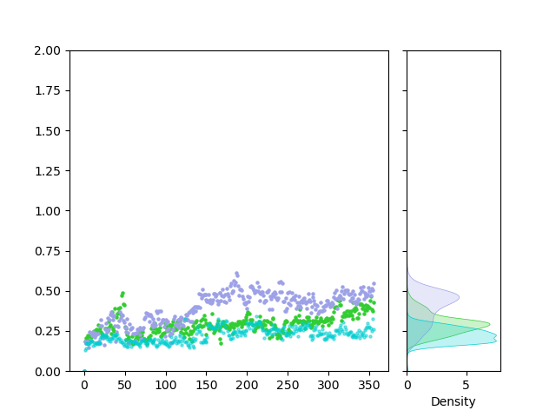
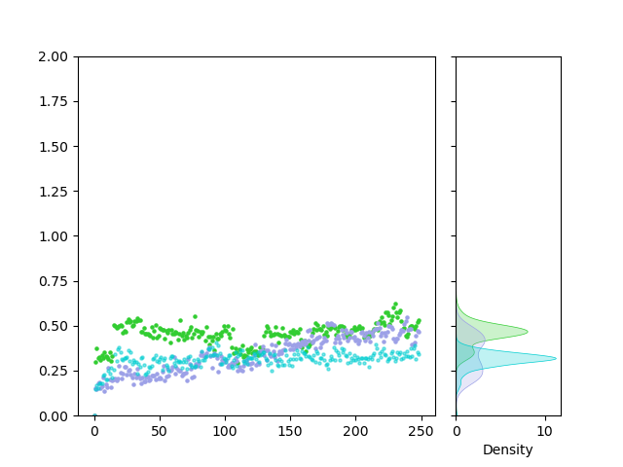
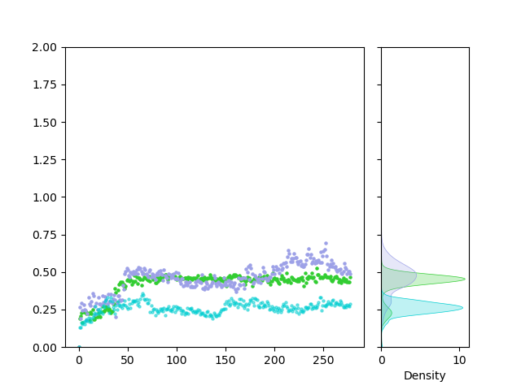
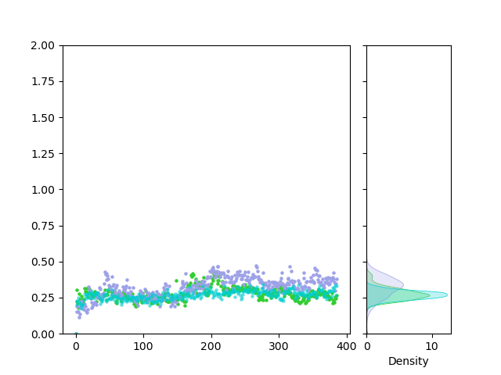
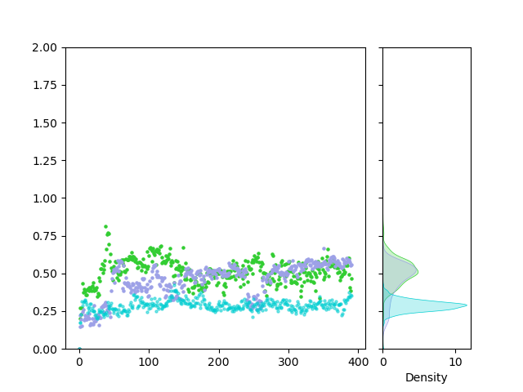
VHL: BSJ-05-017 : CDK6/4 : p18/27 : cyclinD simulations (400.15 K)
CDK6_run 0
CDK6_run 1
CDK6_run 2
VHL
BSJ-05-017
CDK6
Backbone RMSD (nm)
0 50 100 150 200 250 300 350
0 10
Density
0 50 100 150 200 250 300 350
0 5
Density
0 10
Density
CDK4_run 0
CDK4_run 1
CDK4_run 2
VHL
BSJ-05-017
CDK4
Backbone RMSD (nm)
0 10
Density
0 10
Density
0 10
Density
simulation time (ns)
simulation time (ns)
simulation time (ns)

Slide 9
CRBN

Slide 10
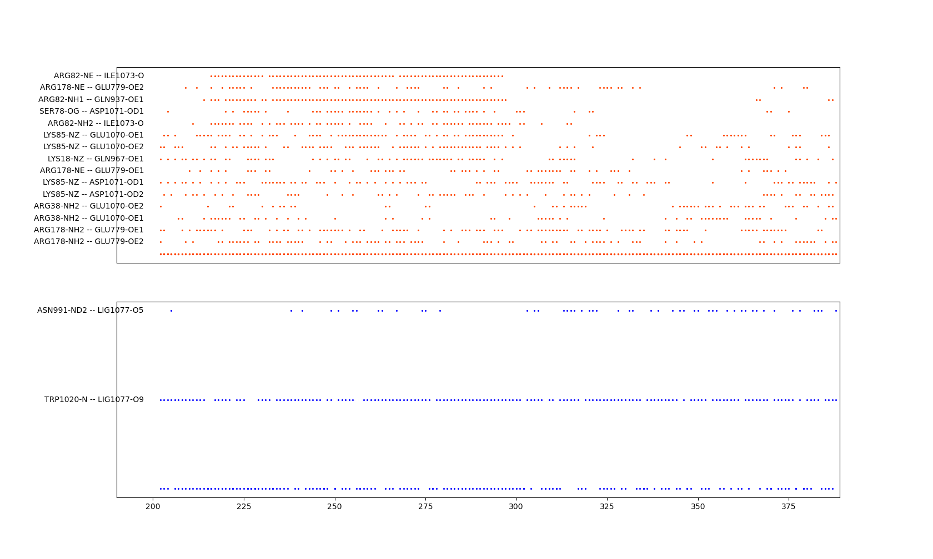
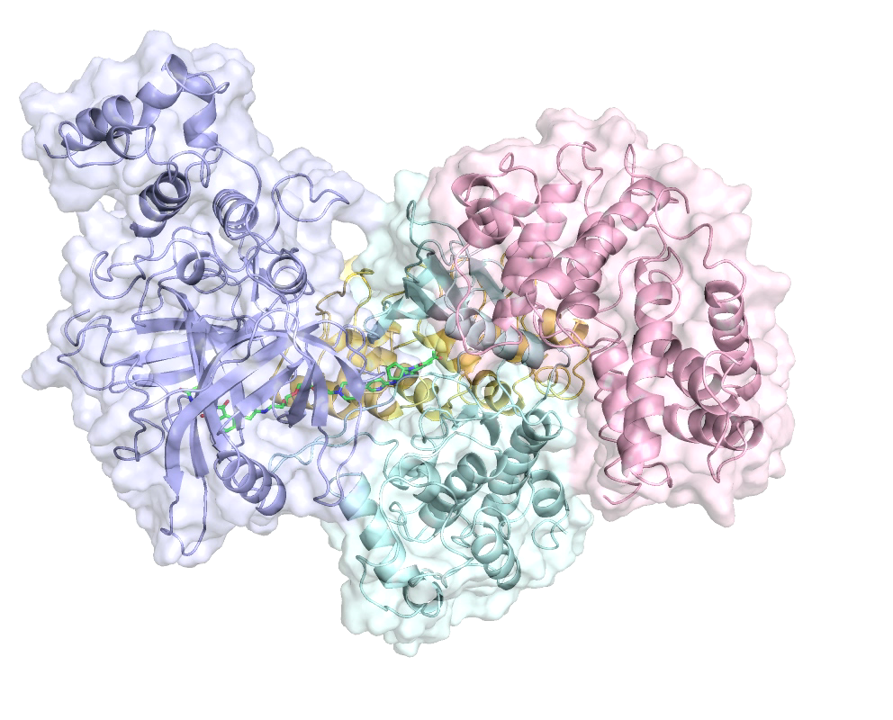
CRBN: BSJ-03-123 : CDK6 : p18 : cyclinD simulations (400.15 K)
1/4
CDK6_run 0, 388 ns
Backbone RMSD (nm)
0 50 100 150 200 250 300 350
CRBN: E779, Q937, Q967, E1070, D1071, I1073
CDK6: K18, R38, S78, R82, K85, R178
Ligand: N991, W1020
P18
simulation time (ns)
PROTAC
h-cyclinD1
CRBN
CDK6

Slide 11
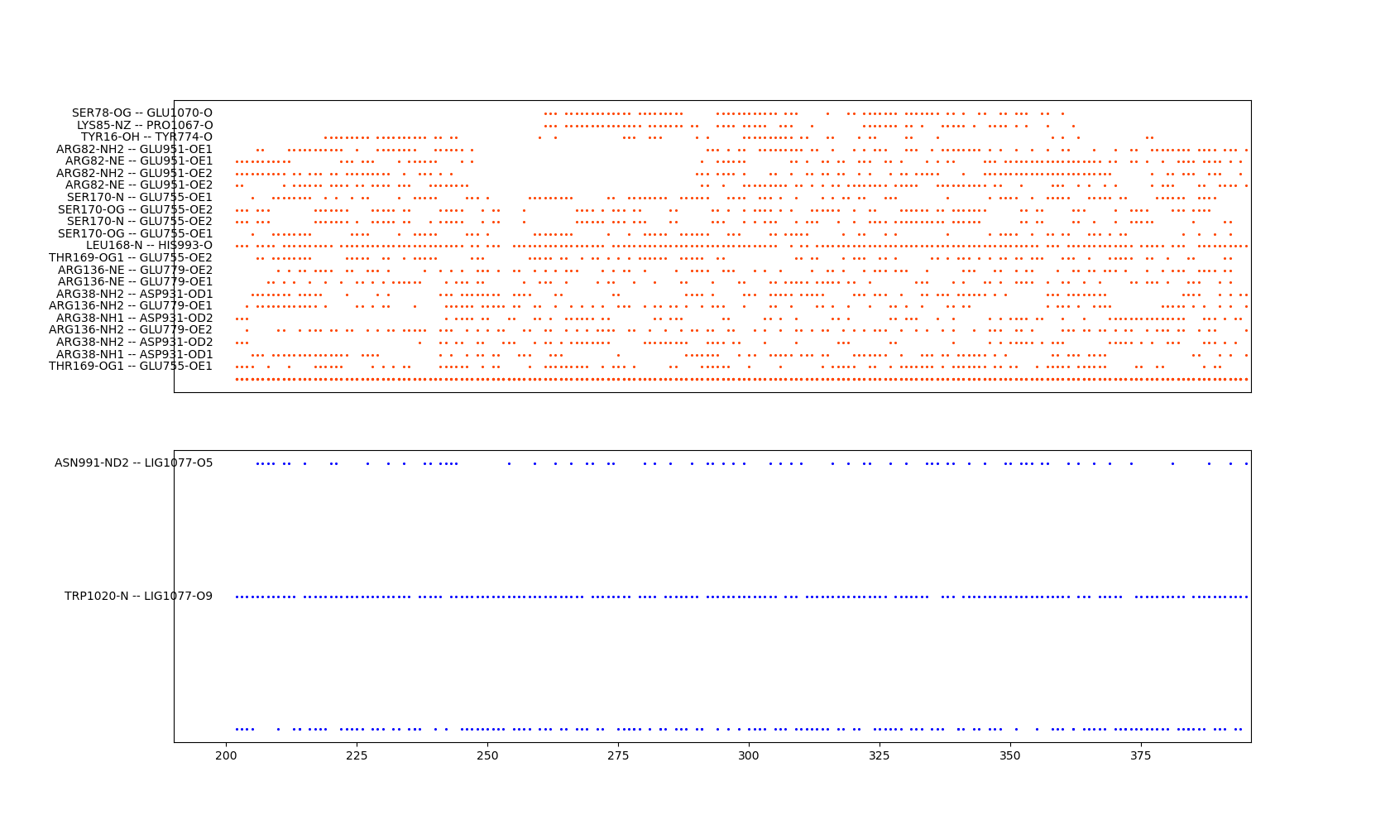
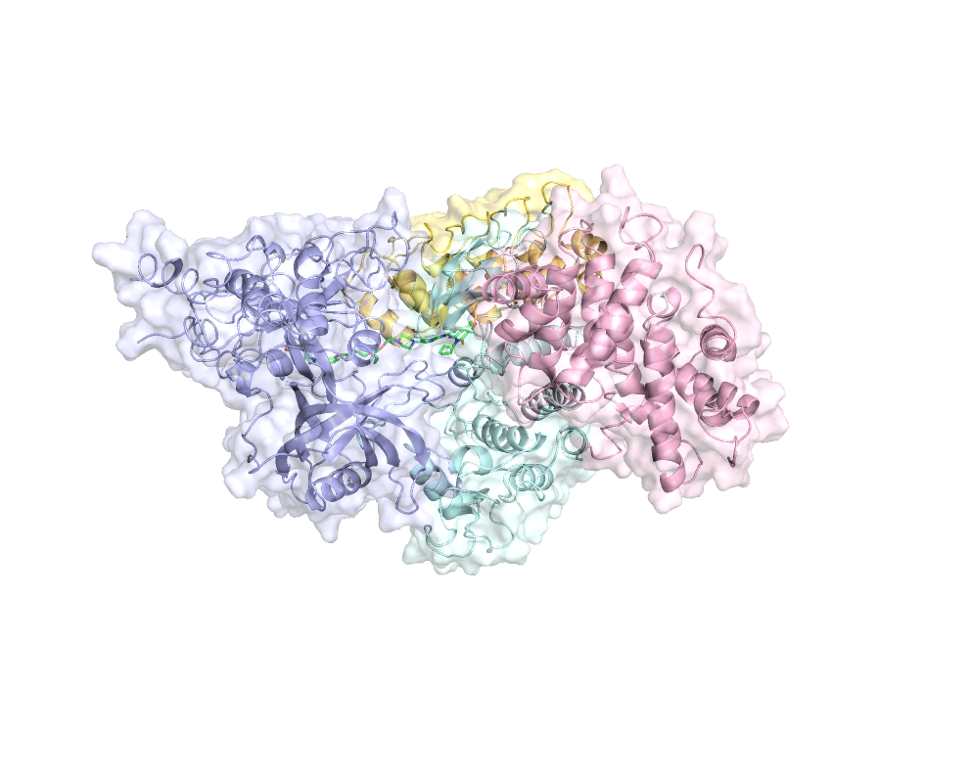
CRBN: BSJ-03-123 : CDK6 : p18 : cyclinD simulations (400.15 K)
1/4
CDK6_run 1, 395 ns
Backbone RMSD (nm)
0 100 200 300 400
CRBN: E755, Y774, E779, D931, E951, H993, P1067, E1070
CDK6: Y16, R38, S78, R82, K85, R136, L168, T169, S170
Ligand: N991, W1020
simulation time (ns)
P18
PROTAC
CRBN
h-cyclinD1
CDK6

Slide 12
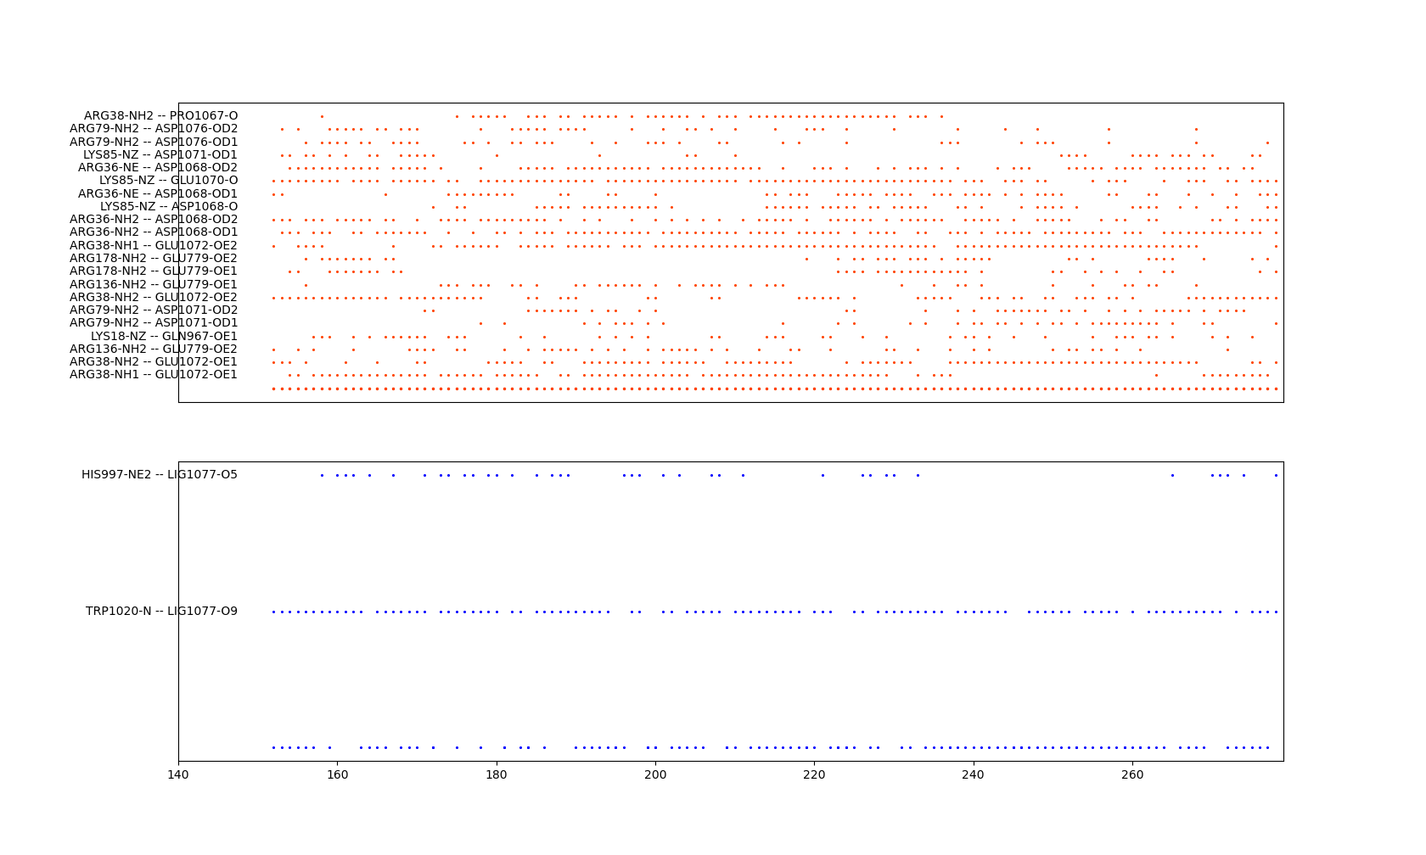
CRBN: BSJ-03-123 : CDK6 : p18 : cyclinD simulations (400.15 K)
1/4
CDK6_run 2, 278 ns
Backbone RMSD (nm)
Consensus:
CRBN: E755, Y774, E779, D931, Q937, E951, Q967, H993, P1067, D1068, E1070, D1071, E1072, I1073, D1076
CDK6: Y16, K18, R38, S78, R82, K85, R136, L168, T169, S170, R178
Ligand: N991, H997, W1020
0 50 100 150 200 250
simulation time (ns)

Slide 13
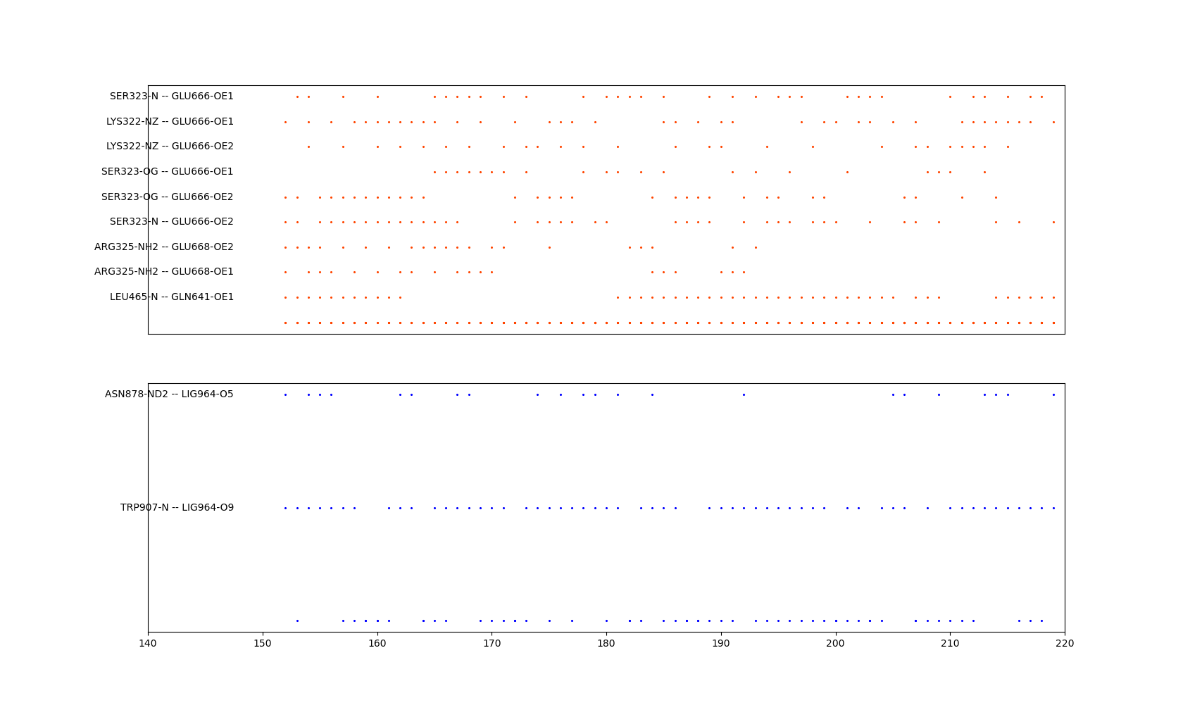
CRBN: BSJ-03-123 : CDK4 : p27 : cyclinD simulations (400.15 K)
1/4
CDK4_run 0, 219 ns
Backbone RMSD (nm)
0 50 100 150 200
CRBN: Q641, E666, E668
CDK4: K322, S323, R325, L465
Ligand: N878, W907
simulation time (ns)

Slide 14
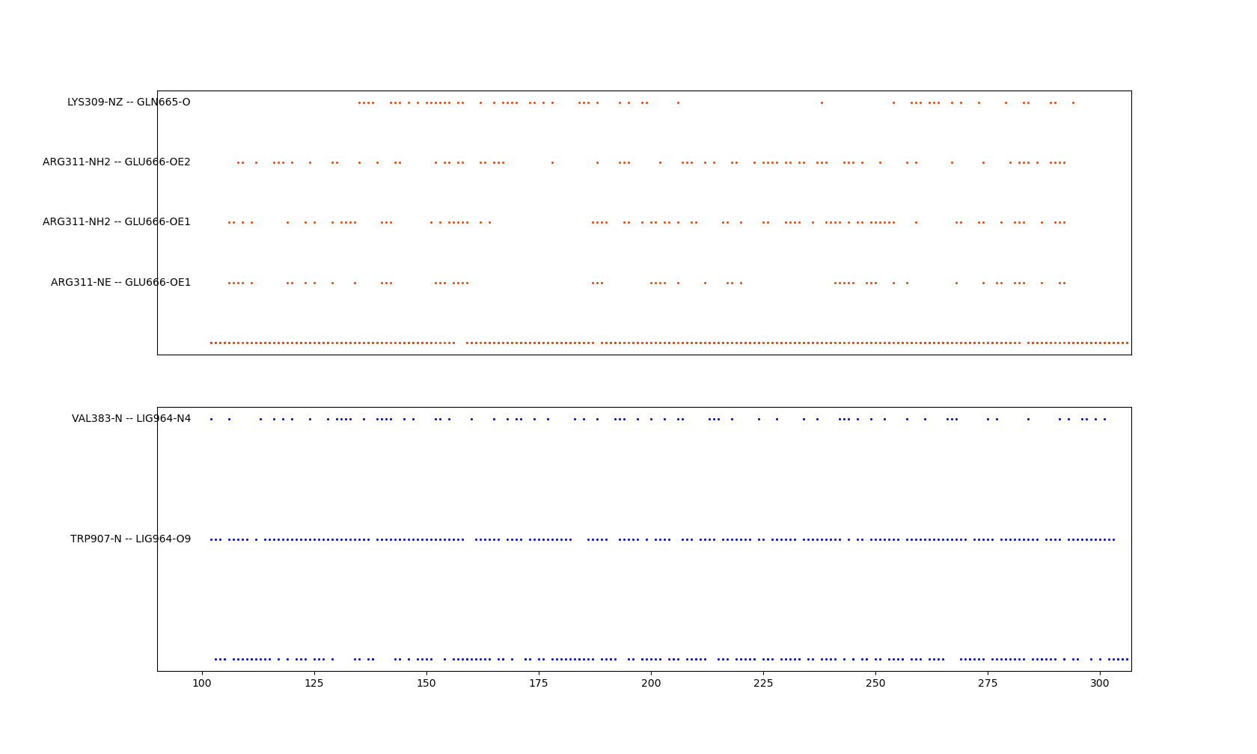
CRBN: BSJ-03-123 : CDK4 : p27 : cyclinD simulations (400.15 K)
1/4
CDK4_run 1, 306 ns
Backbone RMSD (nm)
CRBN: E666
CDK4: K309, R311
Ligand: V383, W907
0 50 100 150 200 250 300
simulation time (ns)

Slide 15
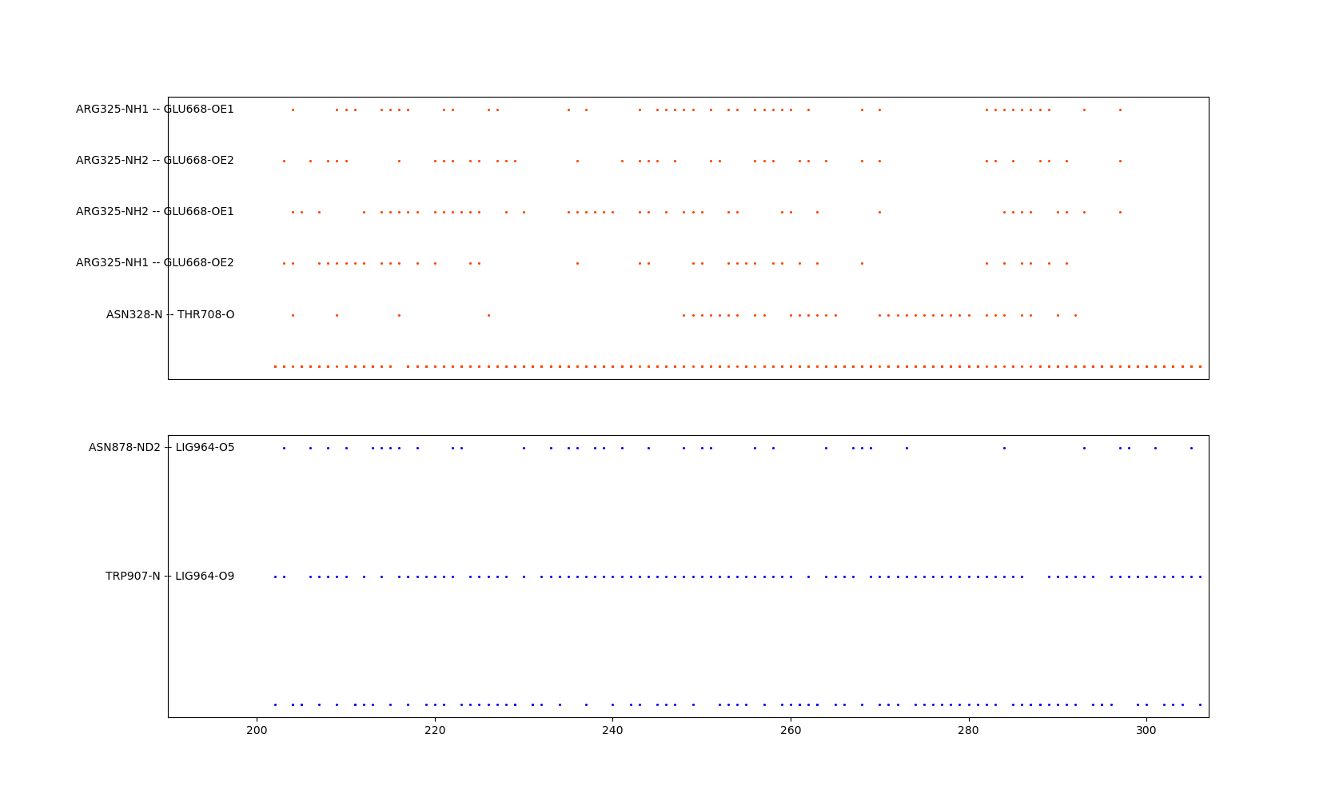
CRBN: BSJ-03-123 : CDK4 : p27 : cyclinD simulations (400.15 K)
1/4
CDK4_run 2, 306 ns
Backbone RMSD (nm)
0 50 100 150 200 250 300
simulation time (ns)
Consensus:
CRBN: Q641, E666, E668, T708
CDK4: K309, R311, K322, S323, R325, N328, L465
Ligand: V383, N878, W907

Slide 16
VHL

Slide 17
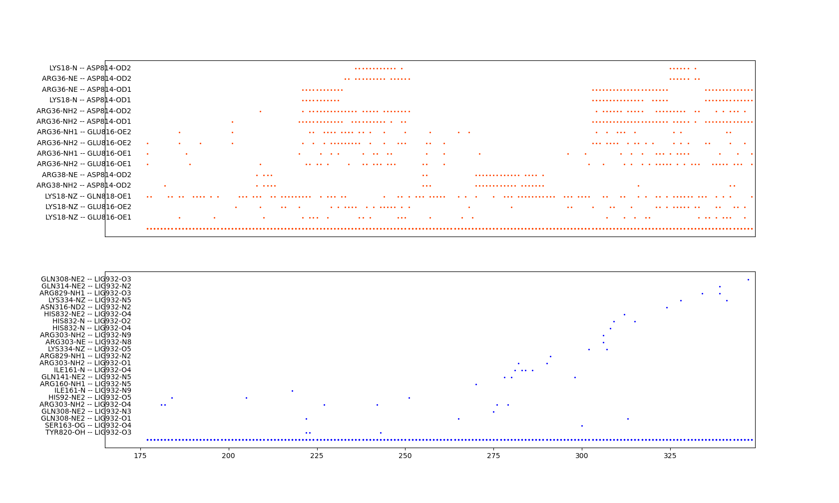
VHL: BSJ-05-017 : CDK6 : p18 : cyclinD simulations (400.15 K)
1/10
VHL: D814, E816, Q818
CDK6: K18, R36, R38

Slide 18
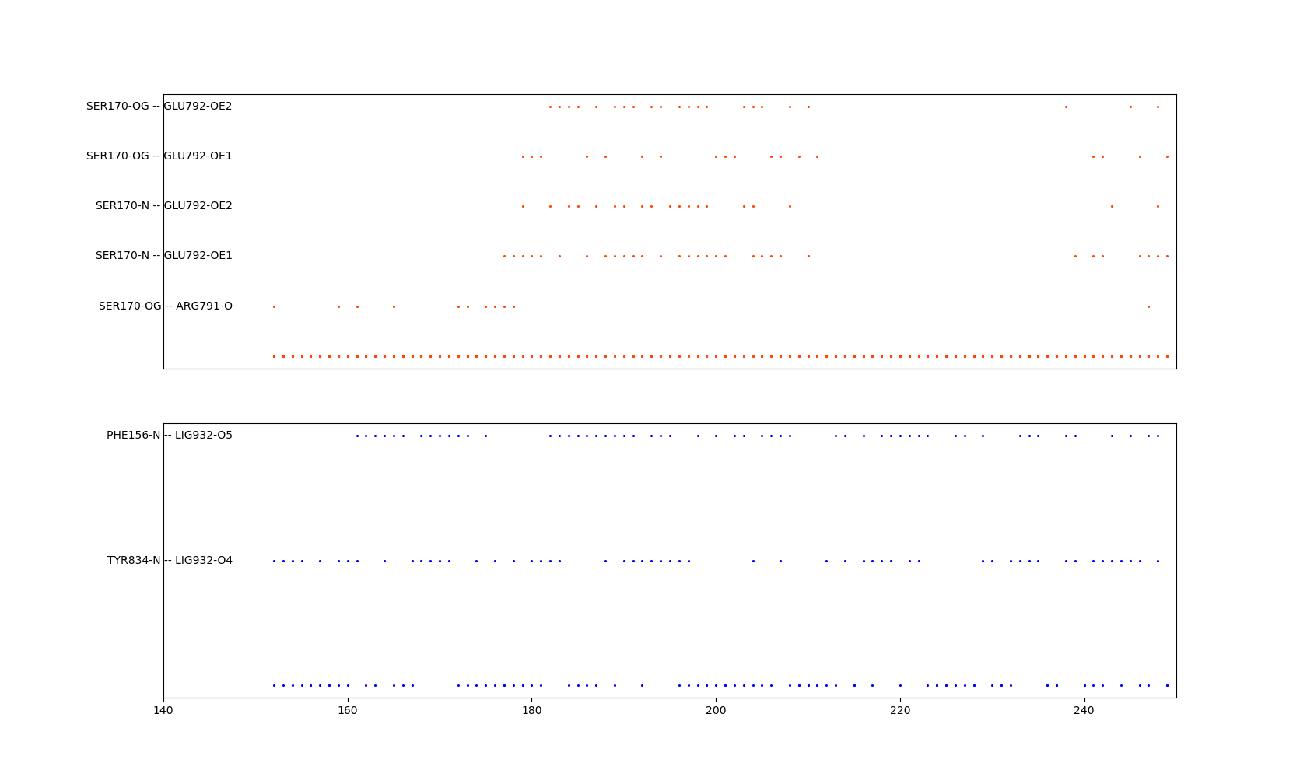
VHL: BSJ-05-017 : CDK6 : p18 : cyclinD simulations (400.15 K)
1/10
VHL: R791, E792
CDK6: S170
Ligand: F156, Y834

Slide 19
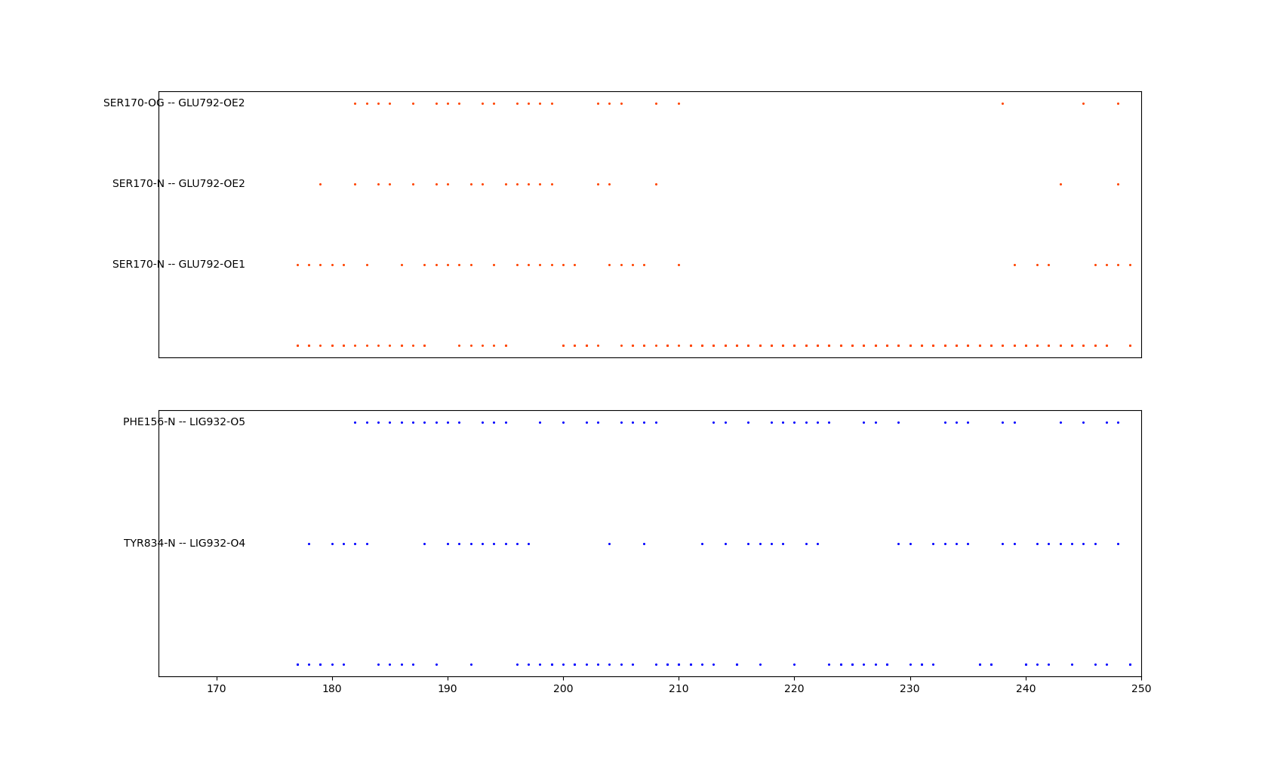
VHL: BSJ-05-017 : CDK6 : p18 : cyclinD simulations (400.15 K)
1/10
Consensus:
VHL: R791, E792, D814, E816, Q818
CDK6: K18, R36, R38, S170
Ligand: F156, Y834

Slide 20
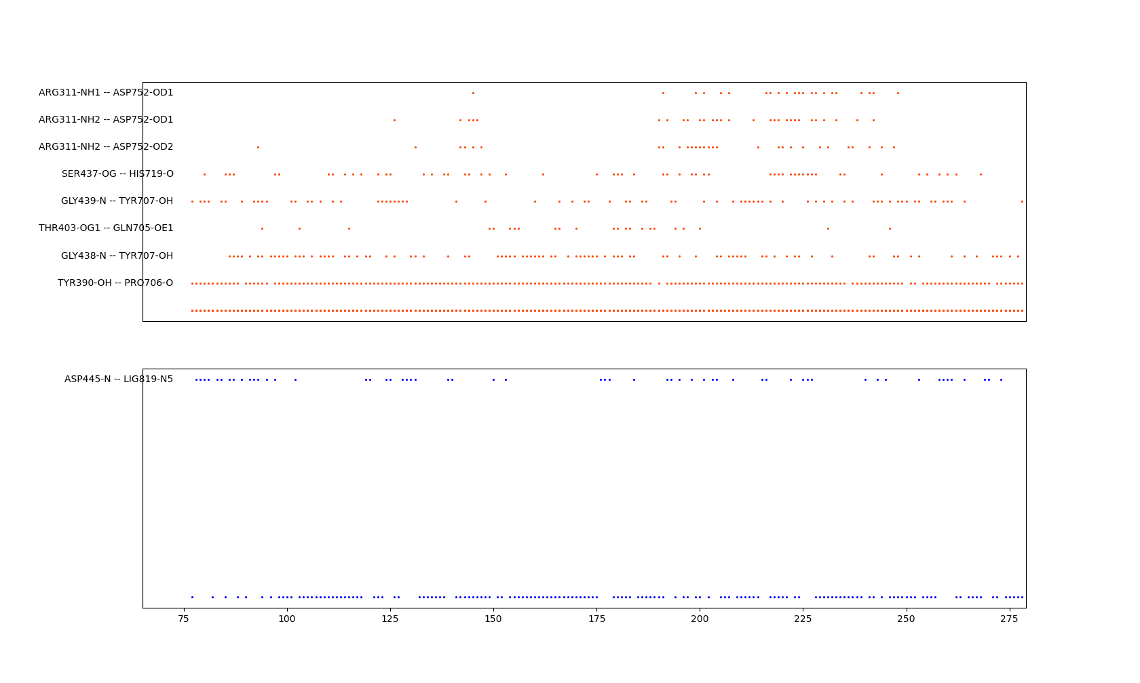
VHL: BSJ-05-017 : CDK4 : p27 : cyclinD simulations (400.15 K)
1/10
VHL: Q705, P706, Y707, H719, D752
CDK4: R311, Y390, T403, S437, G438, G439
Ligand: D445

Slide 21
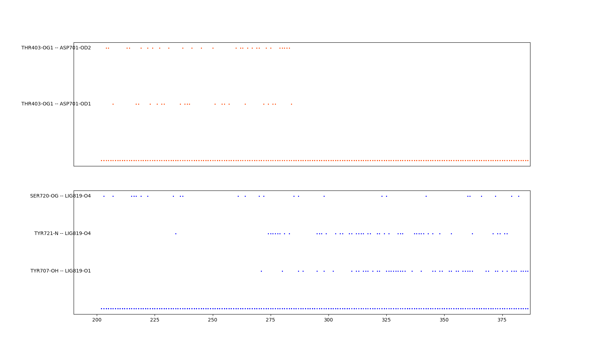
VHL: BSJ-05-017 : CDK4 : p27 : cyclinD simulations (400.15 K)
1/10
VHL: D701
CDK4: T403
Ligand: S720, Y721, Y707

Slide 22
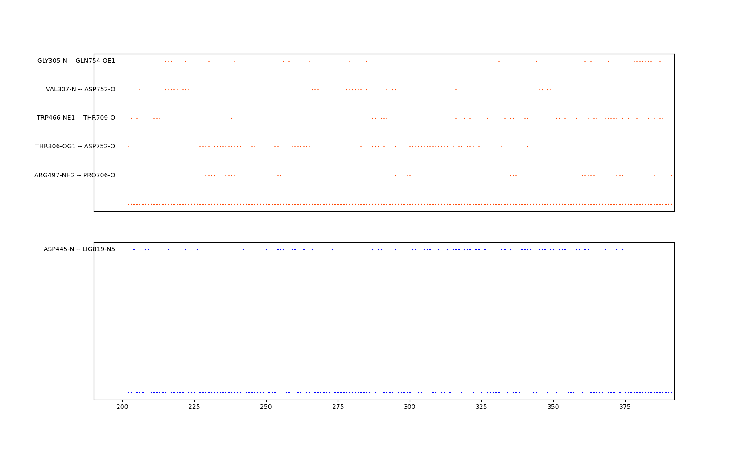
VHL: BSJ-05-017 : CDK4 : p27 : cyclinD simulations (400.15 K)
1/10
Consensus:
VHL: D701, Q705, P706, Y707, T709, H719, D752, Q754
CDK4: G305, T306, V307, R311, Y390, T403, S437, G438, G439, W466, R497
Ligand: D445, S720, Y721, Y707

Slide 23
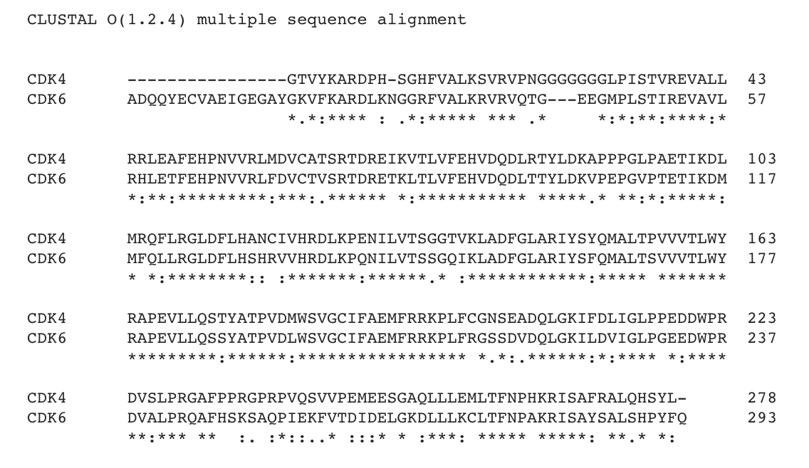

Slide 24
p18 : CDK6 : CRBN at 404.15 K (run0, 388 ns)
P18
PROTAC
CRBN
h-cyclinD1
CDK6

Slide 25
Small Models

Slide 26
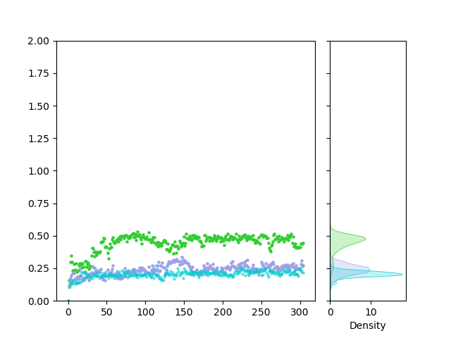
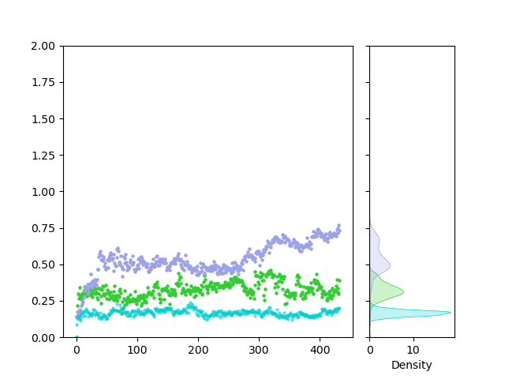
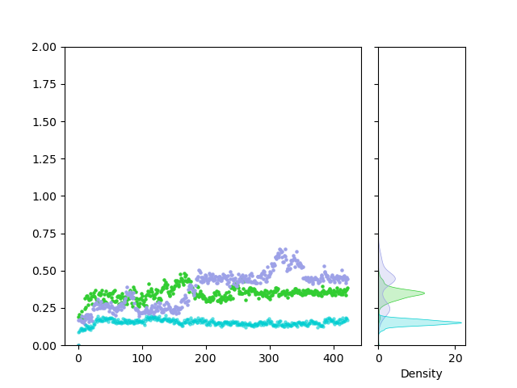
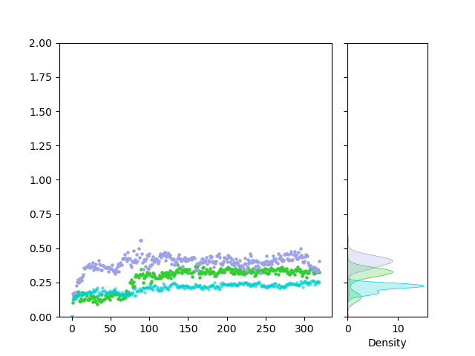
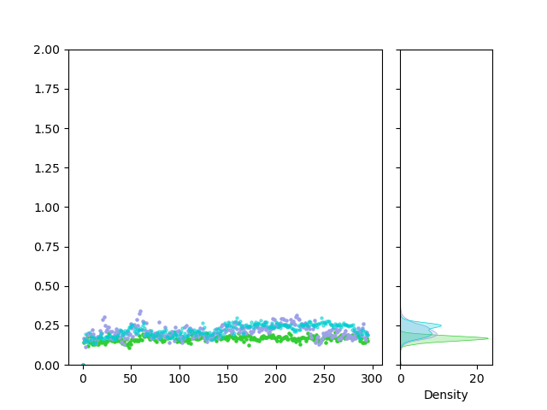

CRBN: BSJ-03-123 : CDK6/4 : cyclinD simulations (303.15 K)
CDK6_run 0
CDK6_run 1
CDK6_run 2
CRBN
BSJ-03-123
CDK6
Backbone RMSD (nm)
0 10
Density
0 100 200 300 400
0 10
Density
0 50 100 150 200 250
CDK4_run 0
CDK4_run 1
CDK4_run 2
CRBN
BSJ-03-123
CDK4
Backbone RMSD (nm)
0 10
Density
0 50 100 150 200 250 300
0 20
Density
0 5
Density
simulation time (ns)
simulation time (ns)
simulation time (ns)

Slide 27






CRBN: BSJ-03-123 : CDK6/4 : cyclinD simulations (400.15 K)
CDK6_run 0
CDK6_run 1
CDK6_run 2
CRBN
BSJ-03-123
CDK6
Backbone RMSD (nm)
0 100 200 300 400
0 5
Density
0 100 200 300 400
0 10
Density
0 50 100 150 200 250 300
0 10
Density
CDK4_run 0
CDK4_run 1
CDK4_run 2
CRBN
BSJ-03-123
CDK4
Backbone RMSD (nm)
0 50 100 150 200 250 300
0 5
Density
0 50 100 150 200 250 300
0 10
Density
0 50 100 150 200 250 300 350
0 10
Density
simulation time (ns)
simulation time (ns)
simulation time (ns)

Slide 28




VHL: BSJ-05-017 : CDK6/4 : cyclinD simulations (303.15 K)
CDK6_run 0
CDK6_run 1
CDK6_run 2
VHL
BSJ-05-017
CDK6
old
old
old
Backbone RMSD (nm)
0 50 100 150 200 250
0 10
Density
0 20
Density
0 50 100 150 200 250
0 20
Density
CDK4_run 0
CDK4_run 1
CDK4_run 2
VHL
BSJ-05-017
CDK4
old
old
old
Backbone RMSD (nm)
0 10
Density
simulation time (ns)
simulation time (ns)
simulation time (ns)

Slide 29






VHL: BSJ-05-017 : CDK6/4 : cyclinD simulations (400.15 K)
CDK6_run 0
CDK6_run 1
CDK6_run 2
VHL
BSJ-05-017
CDK6
old
old
old
Backbone RMSD (nm)
0 50 100 150 200 250
0 5
Density
0 100 200 300 400
0 5
Density
0 100 200 300 400
0 10
Density
CDK4_run 0
CDK4_run 1
CDK4_run 2
VHL
BSJ-05-017
CDK4
old
old
old
Backbone RMSD (nm)
0 100 200 300 400
0 10
Density
0 100 200 300 400
0 5
Density
0 100 200 300 400
0 5
Density
simulation time (ns)
simulation time (ns)
simulation time (ns)

Slide 31



CRBN: BSJ-03-123 : CDK6 : cyclinD simulations (400.15 K)
CDK6_run 0, 429 ns
Backbone RMSD (nm)
0 100 200 300 400
simulation time (ns)
h-cyclinD1
h-cyclinD1
PROTAC
key interactions
CRBN
CRBN
CDK6
CDK6

Slide 32


CRBN: BSJ-03-123 : CDK4 : cyclinD simulations (400.15 K)
CDK4_run 0, 327 ns
Backbone RMSD (nm)
0 50 100 150 200 250 300
simulation time (ns)
h-cyclinD1
PROTAC
h-cyclinD1
key interactions
CRBN
CRBN
CDK6
CDK4

Slide 33
CRBN: BSJ-03-123 : CDK6 : cyclinD simulations (400.15 K)
CDK6_run 0, 429 ns
Backbone RMSD (nm)
0 100 200 300 400

Slide 35
CDK6 : CRBN at 404.15 K (run0, 429 ns)
PROTAC
CRBN
h-cyclinD1
CDK6

